Slide 1
BSL3,ABSL3 Lab Spec. for Bidding
2020/2/23, 2020/3/24, 2020/4/14,
2020/4/19, 2020/7/7, 2020/714,
2020/7/31
PIHCMC

Slide 2
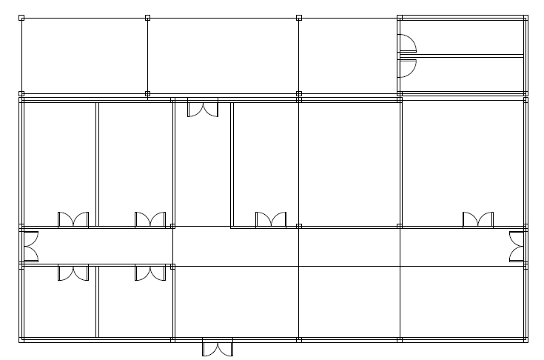
Existing Inside Walls in No.5 Building
Remove
(inside walls and inside doors, except columns and beams)
Note) Existing columns and beams are a few and thin. So confirm structural strength carefully. And reinforce, if needed.
(refer to No.5 building drawing)

Slide 3
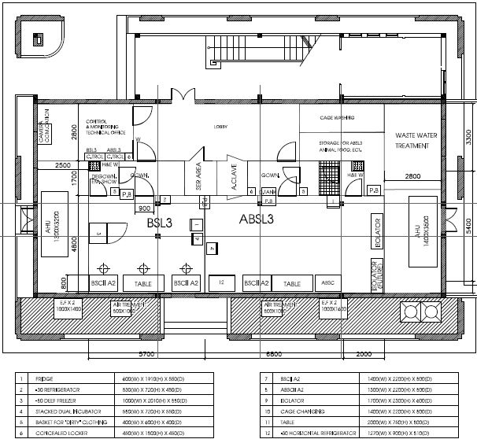
Fire Resistance
Replace
Remove
Note) Windows in concrete wall should be replaced.
(refer to No.5 building drawing)

Slide 4
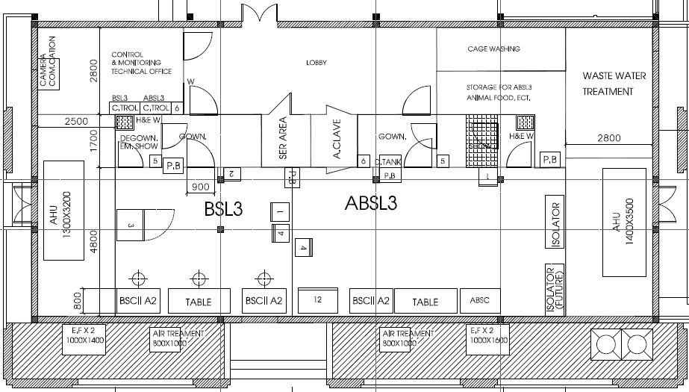
Additional door
V5
Note)
Canceled.

Slide 5
Additional equipment
Floor mounted type autoclave
Sink

Slide 6
Window in inside door
V5
Note) Window size is W300mm and H500mm or more.
Note) In case that clear view is not allowed (Shower room, etc.),
Blind film or other method should be considered.

Slide 7
Door interlock

Slide 8
Door lock and Open/Close Sensor
V6
Note2)
If access record is needed at not only entering room but also exiting room, Button should be changed to Card Reader.
Note3)
Emergency
Lock cancelation is needed.
Door lock and sensor
Card Reader
Button
Note1) Door lock had better be electric magnetic type.

Slide 9
Manometer (Pressure gauge)
V6
Note)
Added.
Note)
Added.
Manometer
Note) Manometer should have proper range.

Slide 10
Camera
V5
Camera
Monitor
Note)
Moved.
Note)
Moved.
Note) Camera should have proper view range and resolution.

Slide 11
Air Tightness
V5
Note) Door’s air tightness
should be 6m3/m2hPa or less.
Note)
Revised.

Slide 12
Heat resistance
Note) Up to 100 degC

Slide 13
Chemical resistance
V5
Note) For alcohol liquid and Formalin gas.
Note) In case of floor, additionally Sodium hypochlorite and Peracetic acid.

Slide 14
Illumination
Note) Timer operation is needed for animal.
500lx or more
300lx or more
200lx or more
Note) Use LED light.

Slide 15
Back up power source
V6
Facility, Equipment or Device | Source | Start up time [min] | Running time [min]
BSC, ABSC | Emergency generator + UPS | around 0 by UPS | around 10 by UPS (for stopping BSC safely)
Isolator | Emergency generator | around 5 | around 60
Refrigerator, Freezer | Emergency generator | around 5 | around 60
Supply fan, Exhaust fan and other equipment for room pressure control | Emergency generator | around 5 | around 20 (for stopping air conditioning system safely)
Lighting equipment in BSL3 and ABSL3 | Emergency generator | around 5 | around 20 (for escape safely)
Others | None | ‘- | ‘-
Note1) Emergency generator in PIHCMC can be used, if it has enough capacity.
Note2) Door lock, Camera, Intercom and other security item should be back-up, if needed.

Slide 16
Temperature control
22 to 26
degC
20 to 28
degC
40 or less
degC
80 or less
degC

Slide 17
Humidity control
V5
Note)
Revised.
45 to 55
%RH
50 to 70
%RH
40 to 80
%RH
80 or less
%RH

Slide 18
Air change rate
Note) 6 times/h or more at stand-by mode in case of
20 times/h or more
12 times/h or more
1 times/h or more
Not specified

Slide 19
Pressure control
-80 to -100
Pa
-50 to -70
Pa
-20 to -40
Pa
Around 0
Pa

Slide 20
Air conditioning system (Reference)
V6
RF
RF
RF
MF
BPD
AHU
EF
EF
EF
SF
SF
PCD
PCD
VCD
HF
HF
HF
HF,
EF
HF,
EF
HF,
EF
RA
BSC
AC
BSL3, ABSL3
Corridor,
Control room, Cage wash room
Autoclave room,
Machine room, Storage
Abbr.) RF: Rough Filter, MF: Medium Efficiency Filter, HF: HEPA Filter, PCD: Pressure Control Damper,
VCD: Volume Control Damper, AHU: Air Handling Unit, BPD: By-Pass Damper, EF: Exhaust Fan,
SF: Supply Fan, BSC: Bio Safety Cabinet, AC: Autoclave, RA: Room Air conditioner

Slide 21
HEPA filter casing (Reference)
Abbr.)
GV: Gate Valve,
BV: Butterfly Valve,
PG: Pressure gauge,
PS: Pressure Sensor
PS
PG
Access door
Access hole
Note1) Casing can be manufactured by spot welding and sealing.
Note2) HEPA filter has gasket on bottom side.
Note3) Access door has gasket. Gasket should have no seam.
Note4) Flange on both side of BV can be manufactured by steal plate.
Note5) Both GV should be closed except in sterilization. Fan and hose installed between both GV to circulate sterilization gas.
HEPA filter
Air flow
GV
BV

Slide 22
Drainage water system (Reference)
V6
Cage Wash
room
Abbr.)
HW: Hand Wash,
SP: Shower Pan,
DT: Dunk Tank,
AC: Autoclave,
ST: Storage Tank,
HF: HEPA Filter,
P: Pump,
WTS: Water Treatment System
PDS: Public Drainage System
Lab room, Anteroom
Autoclave
room
Water treatment room
HF
HF
P
HW
DT
AC
Sink
WTS
SP
Vent
PDS
ST
PDS
Note1) DT’s drainage water can be connected directly with PDS.
Note2) If AC is anti-bio-hazard type, its drainage water can be connected directly with PDS.
Note3) AC’s drainage water is very hot and has pressure.
Note4) Drainage system piping under floor had better be installed in trench.
Note5) HW, SP should have trap. Its water seal height should be 75mm or more.

Slide 23
Control & Monitor system (Reference)
Room Pressure | VCD opening ratio | System On/Off | Buzzer On/Off
Room Temperature | PCD opening ratio | Buzzer Reset | AHU Fan On/Off
Room Humidity | BPD opening ratio | Door Open/Close | AHU Comp. On/Off
Filter Pressure | Humidifier control | AHU Alarm | EF On/Off
… | … | BSC On/Off | Door Lock On/Off
… | … | … | …
Analog Input | Analog Output | Digital Input | Digital Output
PLC
Graphic Panel (Local) |  | Ethernet (Remote)
Abbr.) PLC: Programmable Logic Controller, Comp: Compressor

Slide 24
CO2 gas supply
V5
CO2 gas piping
CO2 gas cylinders
Note) CO2 gas piping should include Manifold, Pressure reducing valve, Pressure gauge.

Slide 25
Access flow
V6
For person normally
For person in case of high risk
(1 way)
For large equipment

Slide 26
Intercom
V6
Intercom
Note) Extension phone is better, if possible.

Slide 27
Waste water treatment system (Reference)
V7
Cage Wash
room
Abbr.)
HW: Hand Wash,
SP: Shower Pan,
DT: Dunk Tank,
AC: Autoclave,
ST: Storage Tank,
HF: HEPA Filter,
P: Pump,
WTS: Water Treatment System
PDS: Public Drainage System
Lab room, Anteroom
Autoclave
room
Water treatment room
HF
HF
P
HW
DT
AC
Sink
WTS
SP
Vent
PDS
ST
PDS
Note1) DT’s drainage water can be connected directly with PDS.
Note2) If AC is anti-bio-hazard type, its drainage water can be connected directly with PDS.
Note3) AC’s drainage water is very hot and has pressure.
Note4) Drainage system piping under floor had better be installed in trench.
Note5) HW, SP should have trap. Its water seal height should be 75mm or more.

